Slide 1






Docker – a Pink Tale
Yoav Aharoni
CTO, Pink Park
https://goo.gl/wYr2kh
JULY 13 / TLV, Israel

Slide 2
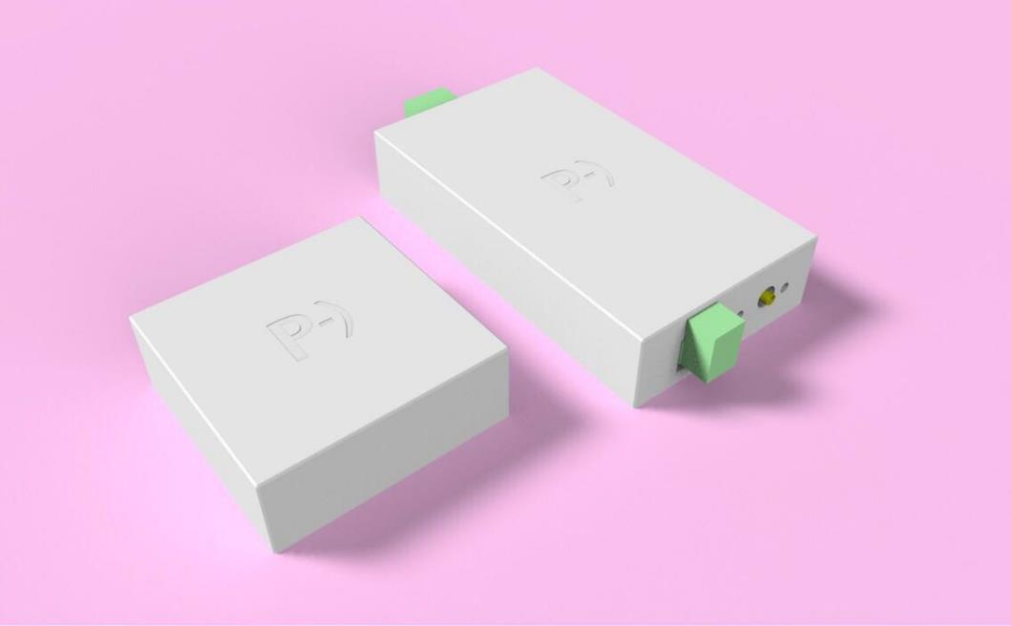

Pink Park – Make Parking a Breeze
HARDWARE
APP
GATE CONNECT
CLOUD
API

Slide 3

Our pink story
https://imgflip.com/memegenerator/True-Story

Slide 4
Stay if {
You want to learn about Docker
You think about starting with Docker
If you like DevOps stories
} else {
Go grab a beer!
}

Slide 5
SO
WHY
DOCKER?

Slide 6

Why Docker?
https://tenor.com/view/kong-kong-movie-john-creilly-neat-groovy-gif-7905260

Slide 7
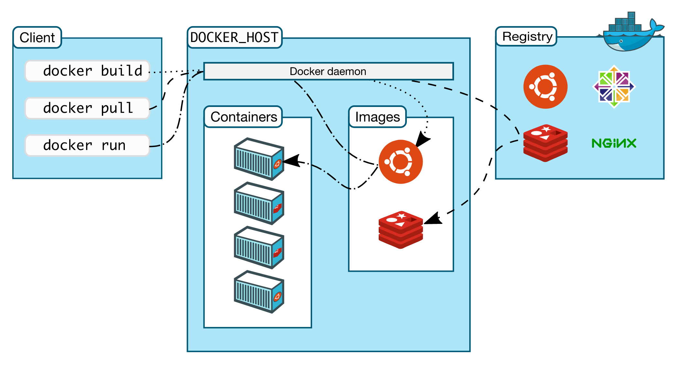
Docker In a Nutshell
https://docs.docker.com/engine/docker-overview/#docker-architecture

Slide 8
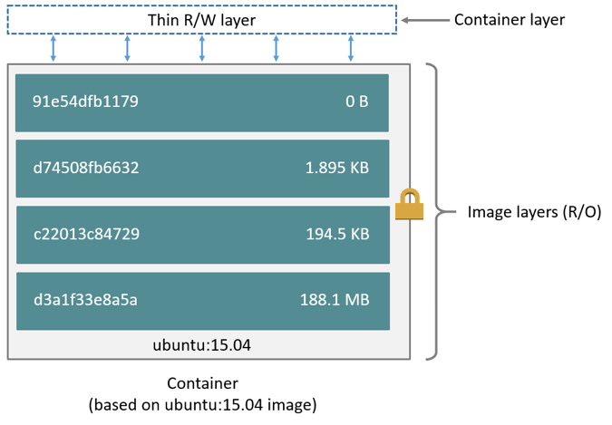
Images are like ogres
https://docs.docker.com/engine/userguide/storagedriver/imagesandcontainers/#images-and-layers

Slide 9
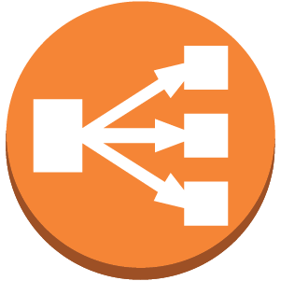
Back to our Story
Prod
Staging / QA
DEVOPS
ELB
ELB
Jenkins
Artifactory
ELK
Nagios
JIRA
Website
PHP
nginx
DevOps
Backend
Java
Frontend
NodeJS
Backend
Java
Frontend
NodeJS

Slide 10

ONE DOES NOT SIMPLY
WALK WITH DOCKER INTO PRODUCTION
https://imgflip.com/memetemplate/One-Does-Not-Simply

Slide 11
Jenkins Container
Search Docker Hub, find and run this:
Run commands inside a container (--interactive –tty)
Basic stuff:
$ docker run -p 8080:8080 -p 50000:50000 jenkins
$ docker exec –it jenkins bash
$ docker run -p 80:8080 –d --name myjenkins jenkins

Slide 12

Config & Data? Containers are disposable…
Ah, OK!
https://imgflip.com/memetemplate/Frustrated-Boromir

Slide 13
Persistent Data in Containers
Mount a host folder:
Or use a volume container:
Volumes are Preferable: portable, existing image files are kept
Annoyance : Can only be accessed through containers
$ docker run -p 8080:8080 -p 50000:50000 \
-v /your/home:/var/jenkins_home jenkins
docker run -p 8080:8080 -p 50000:50000 \
-v jenkins_data:/var/jenkins_home jenkins

Slide 14

Keeping Containers Alive
Upstart!?
Restart policy
$ docker run \
--restart always
| unless-stopped
| on-failure
Use --restart!
https://memegenerator.net/Typical-Bender

Slide 15
“Dockerized” My Scripts
👍 Work with any scripting language
👍 Without locally installing or updating its binaries
👍 Won’t clutter local machine with script dependencies
👍 Share versioned scripts without git
docker run -it --rm \
… \
-v "$dir/$script_file":/usr/src/script/$script_file \
-v script_node_modules:/usr/src/script/node_modules \
-w /usr/src/script node \
/bin/bash -c "yarn install && node $script_file"

Slide 16
Setup ELK w/ docker-compose
Run and maintain several containers all at once
elasticsearch
kibana
logstash
nginx
Create a docker-compose.yml and just
$ docker-compose up -d

Slide 17

Side effect – 1 line README files
Concise methodology for storing containers configuration
Even when running just one container
No docs, no scripts
https://giphy.com/gifs/dancing-fresh-prince-of-bel-air-carlton-pa37AAGzKXoek

Slide 18
Dockerfile
FROM node:alpine
RUN mkdir -p /usr/src/app
WORKDIR /usr/src/app
COPY package.json /usr/src/app/
RUN yarn install
COPY . /usr/src/app
EXPOSE 8080
CMD [ "npm", "start" ]

Slide 19
Dockerfile – Tips worth mentioning
Aggregate RUN commands whenever possible, each RUN is committed separately
Always manually set -Xmx for Java apps
Use Alpine (or other minimal distro) as base
Decrease attack surface
Smaller size
Faster build

Slide 20
We got out of Docker
👍 DevOps servers maintainability
👍 Scripting heaven (killed install overhead)
👍 Concise methodology for setting things up (shorter docs)

Slide 21

Deploying with Docker & Jenkins
http://m.memegen.com/7sbgqa.jpg

Slide 22
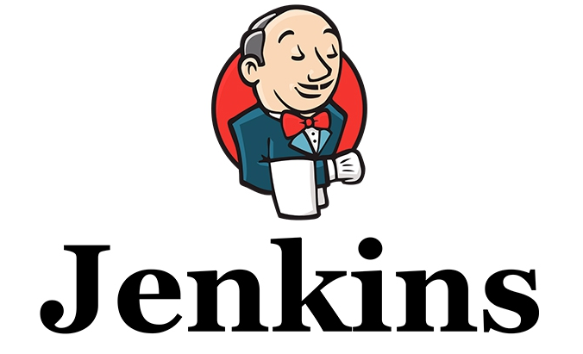
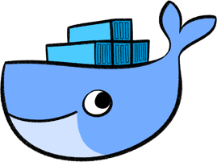
Docker & Jenkins
Docker Plugins: https://plugins.jenkins.io/?q=docker
For Pipelines - Docker Pipeline Plugin
Or sh ‘’

Slide 23
Deploying with Docker - Perks
👍 Proven production reliability
👍 QA guy can test several branches easily
👍 Better automated testing (closer to prod, full system tests)
👍 Standard documented solution = easier hand-off
👍 Servers maintainability
👍 Scripting heaven (killed install overhead)
👍 Concise methodology for setting things up (shorter docs)

Slide 24
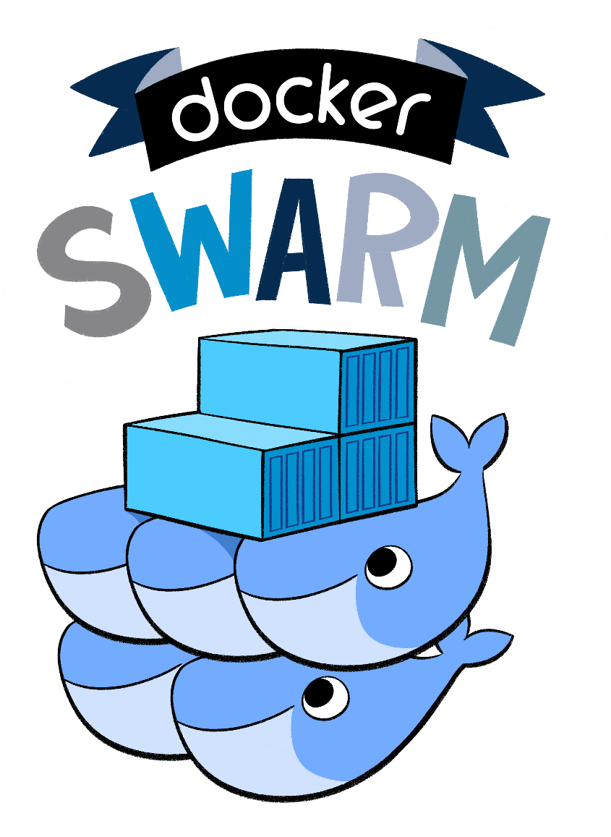
https://blog.docker.com/media/2015/11/logo-title-final-swarm-2d.png

Slide 25
Docker Swarm Mode
Easily create container clusters
Orchestration and scheduling
Uses an upgraded docker-compose YAML (v3)
You Define Services, Swarm dispatches them as Tasks to Nodes
$ docker swarm init
$ docker swarm join –token <tkn> <mngr-ip>
$ docker stack deploy \
–c myapp.yml myapp --with-registry-auth

Slide 26
Swarm Features
Decentralized design
Declarative service model
Scaling
Desired state reconciliation
Multi-host networking
DNS Service discovery
Service discovery
Secure by default
Rolling updates

Slide 27
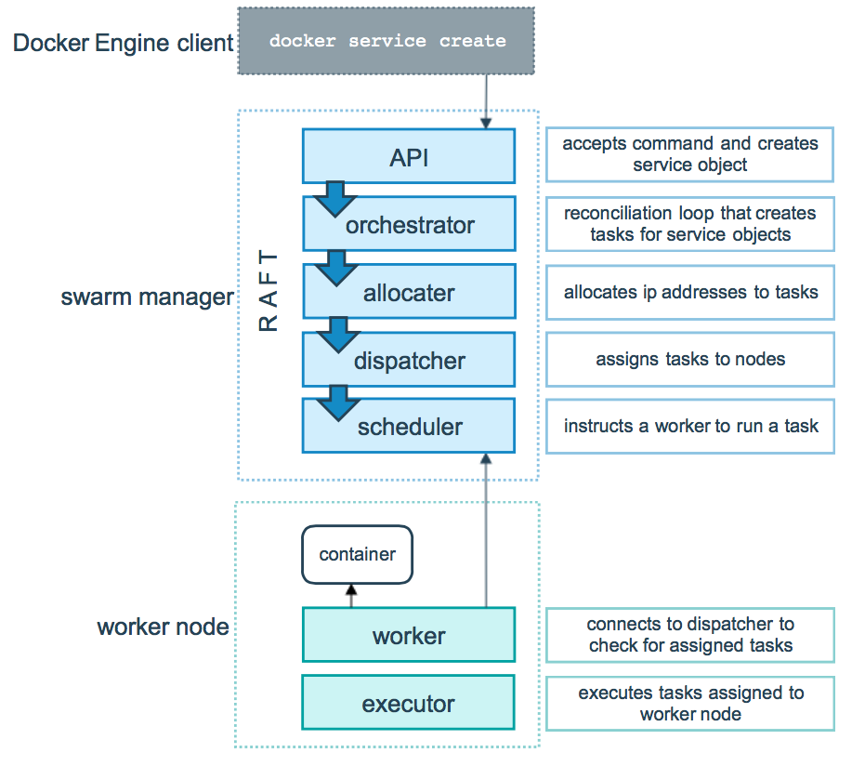
Swarm Service Lifecycle

Slide 28
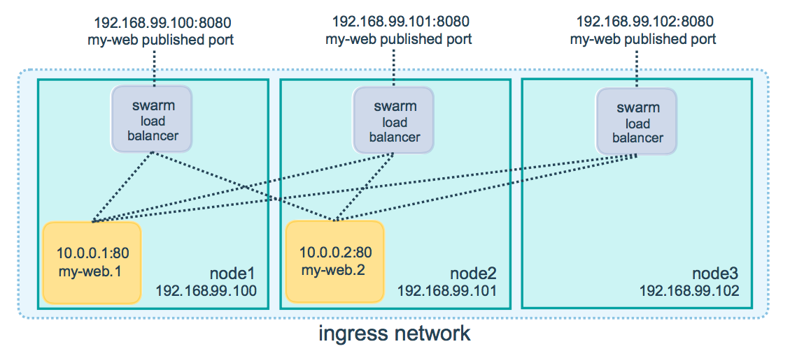
Ingress Routing Mesh
https://docs.docker.com/engine/swarm/ingress/

Slide 29
Swarm Tips
Can’t really swarm with Docker for Mac (use VM/docker-machine)
An odd number of manager nodes is recommended
Configure healthcheck for your app
Lock your swarm
It’s a good practice to have a “manager only” node
$ docker swarm update --autolock=true
$ docker node update \
--availability drain <NODE>

Slide 30
Get this talk
https://goo.gl/wYr2kh

Slide 31

Thank you!
Yoav Aharoni
CTO, Pink Park
www.linkedin.com/in/yoavaharoni/
JULY 13 / TLV, Israel

Slide 32
Recommended Readings
https://docs.docker.com/get-started/
http://docker-saigon.github.io/post/Docker-Caveats/
http://blog.kubernetes.io/2015/06/the-distributed-system-toolkit-patterns.html
https://developers.redhat.com/blog/2017/03/14/java-inside-docker/
https://docs.docker.com/engine/swarm/swarm-tutorial/
http://docker-saigon.github.io/post/Docker-Caveats/
http://www.stuartellis.name/articles/jenkins-pipeline/
https://github.com/veggiemonk/awesome-docker#utilities

